Slide 1

Visualization of Crime dataset
Duyen Nguyen
Gayatri Pant
Anupama Pokharel
Anoushka Khayar
This Photo by Unknown Author is licensed under CC BY-NC

Slide 2
Dataset​
Is crime in America rising or falling?​
Analyze the crime data from 1975 to 2015 ​
Check the crime rate trend line in Cincinnati, Cleveland and Columbus, three major cities in Ohio​

Slide 3
Data Source​
The dataset is from Kaggle:​
Analyzed data set from 1975-2015 on the four major crimes the FBI classifies as violent — homicide, rape, robbery and assault ​
The crime rate in each category has been calculated per 100,000 residents in the jurisdiction, based on FBI’s estimated population for that year.​
2014 estimated population has been used to calculate 2015 crime rates per capita.​

Slide 4
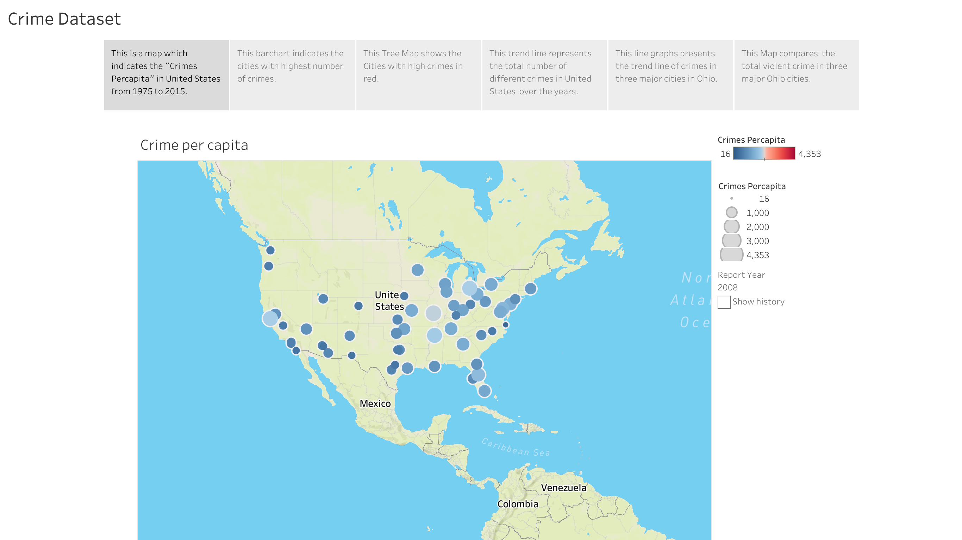

Slide 5
Map
In this Map, we can observe the crime per capita in each of the available city. The size of the circle as well as the color of the circle denotes the crime per capita. The bigger size of the circle indicates higher crime per capita. Similarly with the diverging color palate the darker blue denotes lower crime per capita and darker red denotes higher crime per capita. With this map what we can do is play and see the changes in crime per capita over the years starting from 1975 through 2015.
Observation: 1. 1981 Newark has high crime per capita
2. 1991 Atlanta has the highest
3. Virginia Beach consistently stays on the lower end of the crimes per capita.

Slide 6
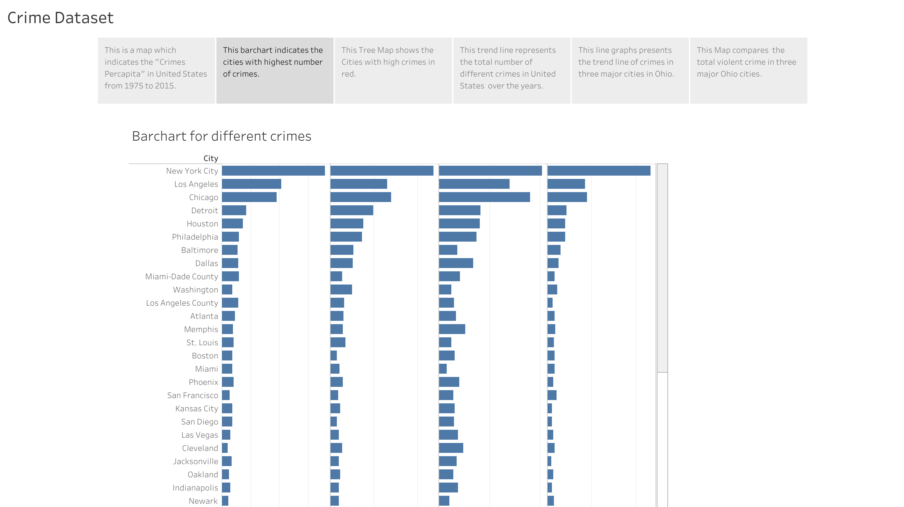

Slide 7
Bar Graph
According to this bar chart, New York city has the highest number of crimes: assaults, homicides, rapes, robberies. Los Angeles’ number of assaults is higher than Chicago, yet its number of homicides, rapes and robberies are lower. Louisville, Fairfax County and Virginia Beach are the three cities that has the least number of crimes.

Slide 8
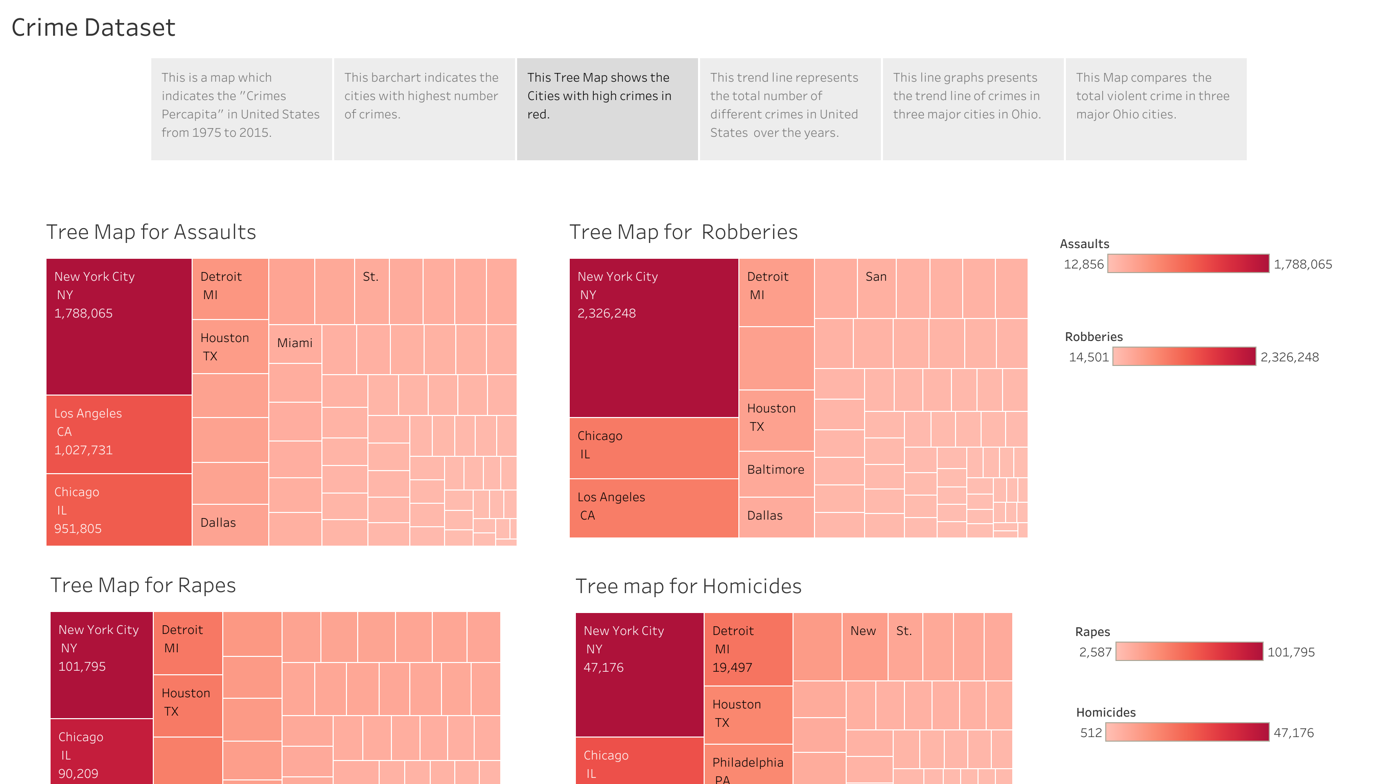

Slide 9
Treemap
In this tree map the big box represents the larger population and small box represents the lower population. Similarly, the dark red color represents the more crime happened and light color represents the less crime happened.
We can see that New York City has the higher number of cases in all crimes than other cities.
Fairfax county has lowest Assaults cases,
Mesa has lowest Robberies and Homicides cases,
Louisville has lowest rapes cases.
Also, we can observe from this tree map that Los Angeles is the second largest city for the Assaults, and
Chicago is the second largest city for the Homicides, Rapes, Robberies.
Here the darker red color indicates that the Rapes is the major crime in Chicago.

Slide 10
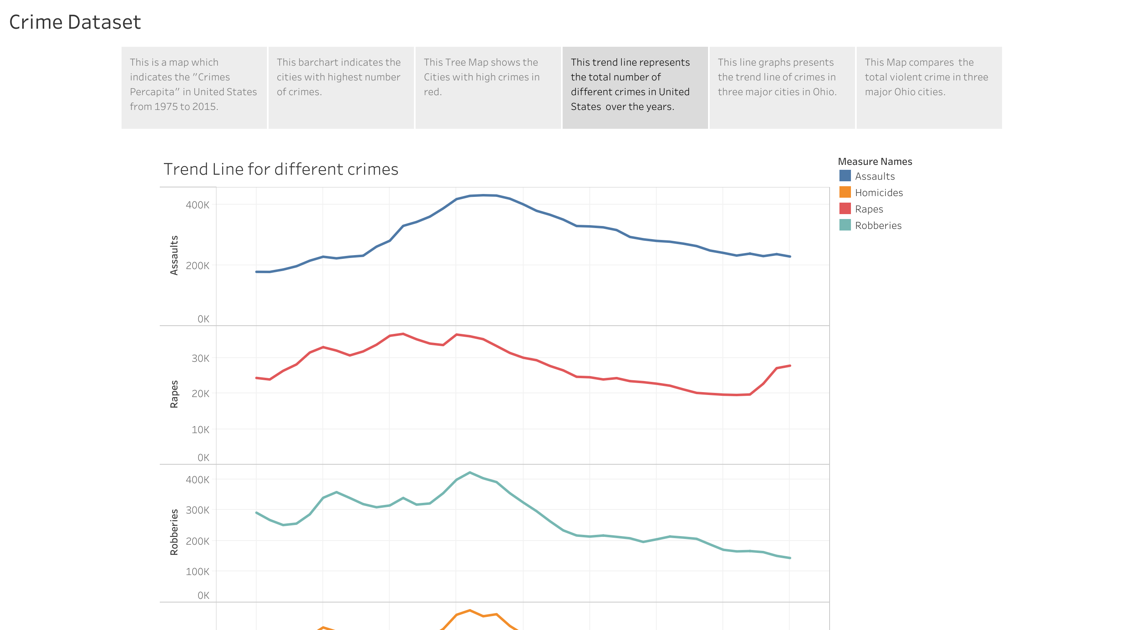

Slide 11
Line Graph
This trend line represents the total number of crimes in united states over the year based on homicides, rape, robbery and assault.
The total number of assault cases in the United States over the year can be seen on the uppermost trendline. We can see that the total number of assault cases in 1975 was around 200k, but this figure began to rise over time. Between 1990 and 1995, the largest number of assault cases were recorded. However, it began to fall after 1995.
The second graph shows the overall number of rape cases reported in the United States over year. From 1975 to 1990, the total number of rape cases fluctuated, with some years being higher than others. However, beginning in 1990 and continuing through 2012, the total number of rape cases began to fall. And, starting in 2012, the number of rape cases began to rise.
The third trendline shows the total number of robbery cases in the unites states over the year.
From 1975 through the early 1990s, the total number of robbery cases appear to have fluctuated. However, the number has significantly decreased since then.
The fourth trendline shows the total number of homicides cases in the unites states over the year. From 1975 to 1990, there was a fluctuation in the total number of homicide cases. However, since the early 1990s, the total number of homicide cases has decreased.
Overall, we can see that there was a rise in crime rate in early 1990s, but the overall crime rates eventually started to decline after 1990s, except the total number of rape cases. After 1990s, the number of rape cases decreased, but after 2012, there was a slight increase in the number of rape crimes.
We investigated why the crime rate in the United States fell after the 1990s and discovered that there are combinations of factors that has caused a decline:
The first factor that has caused a decline is: mass incarcerations. Lots of criminals have been arrested since 1990s which has helped to lower the crime rates in United States.
The second factor is Police strategy. In 1990s, the funding for police increased which helped the police departments to innovate new strategy to lower the crime rates.
The third factor is Compstat. This system helped police officers to measure crime stats and target specific neighborhood and crime starting in 90s.
And the fourth factor is rise in economy. After 1990s, the economy of United States started to grow which cause a decline in crime rates. Although there was a recession in 2008, the crime rate did not increase.

Slide 12
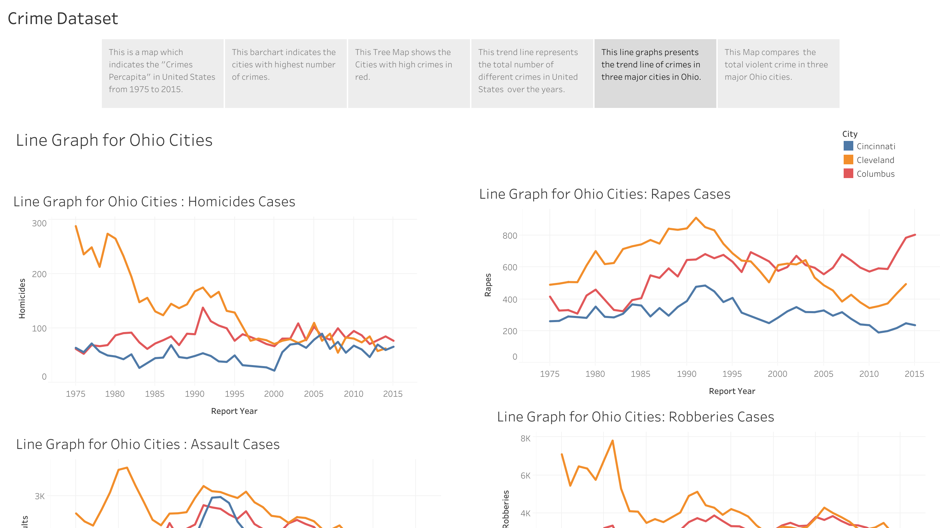

Slide 13
Line Graph
This line graph represents the number of crimes committed in three major Ohio cities over a 40-year period. The first thing that stands out when looking at the chart is that Cleveland seems to have more cases in all four categories.
When it comes to homicides, Cleveland had a high number in the beginning, but it began to decline in the 1980s. Eventually, all three cities have a roughly similar number of homicides.
Moving on to assault cases, Cleveland had a much higher number than the other two cities in the beginning. In Cincinnati, we can see a spike in assault cases in the early 1990s.
In terms of rape cases, we see a very similar trend pattern in all three cities. They all had a peak in 1980 and a second peak around 1991/1992.
In terms of robberies, Cleveland, once again, had a higher rate than the other two cities. In 1981, Cleveland had a very high number of robberies, as seen in assault cases.
We looked into what happened in the 1970s and 1980s because we noticed a very similar pattern in all four different crimes in Cleveland. We discovered that the Italian-American Mafia had a presence in the Greater Cleveland area as early as the 1920s. A violent gang war broke in Cleveland's streets in the late 1970s after an Irish mobster named Danny Greene attempted to take over the city. This war drew the attention of law enforcement, resulting in a decrease in mob membership and influence. After many high-ranking members were imprisoned, the crime family nearly died out in the 1990s. The line chart shows a rise in crime in Cleveland in the late 1970s and early 1980s, followed by a decline in the 1990s, which is understandable given the prevalence of gangs.

Slide 14
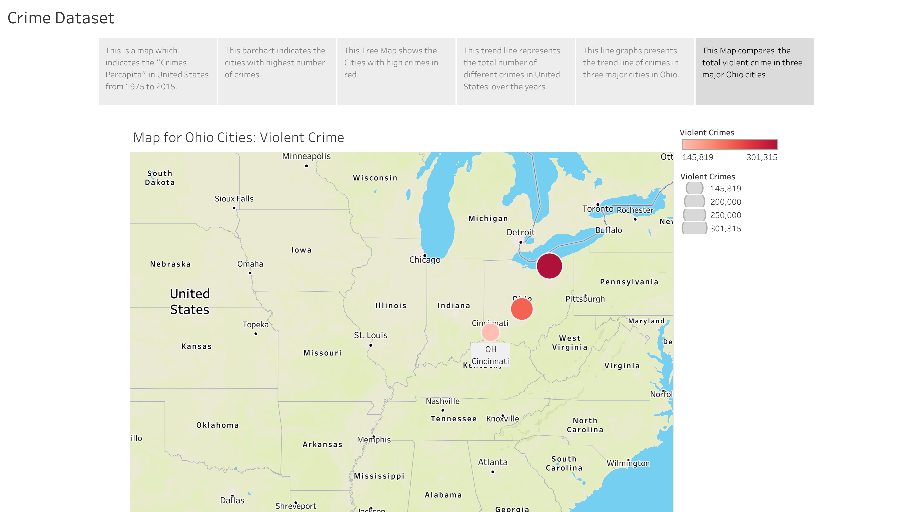

Slide 15
Map
This is the map for Ohio cities, which we used to compare total violent crime in three major cities of Ohio: Cincinnati, Cleveland and Columbus. The bigger size of the circle and the darker red show the higher total crime, and the smaller with lighter red display the lower total crime. According to the map, Cleveland has the highest total number of violent crimes while Cincinnati has the lowest. Cleveland is by far the most dangerous city among those cities. Crimes usually spike in areas of poverty and unemployment. Cleveland’s poverty rate is 35.2% with an annual unemployment rate of 6.5%.

Slide 16

Reference
https://www.kaggle.com/datasets/marshallproject/crime-rates?select=report.csv&fbclid=IwAR0l5W1CC_A8dxm1Z7yTYDjyGsB2hSrmTIC7ckEBvfa_B4awGElSV2MS9xQ
https://www.clevelandcrib.org/mob-mafia/

